Slide 1

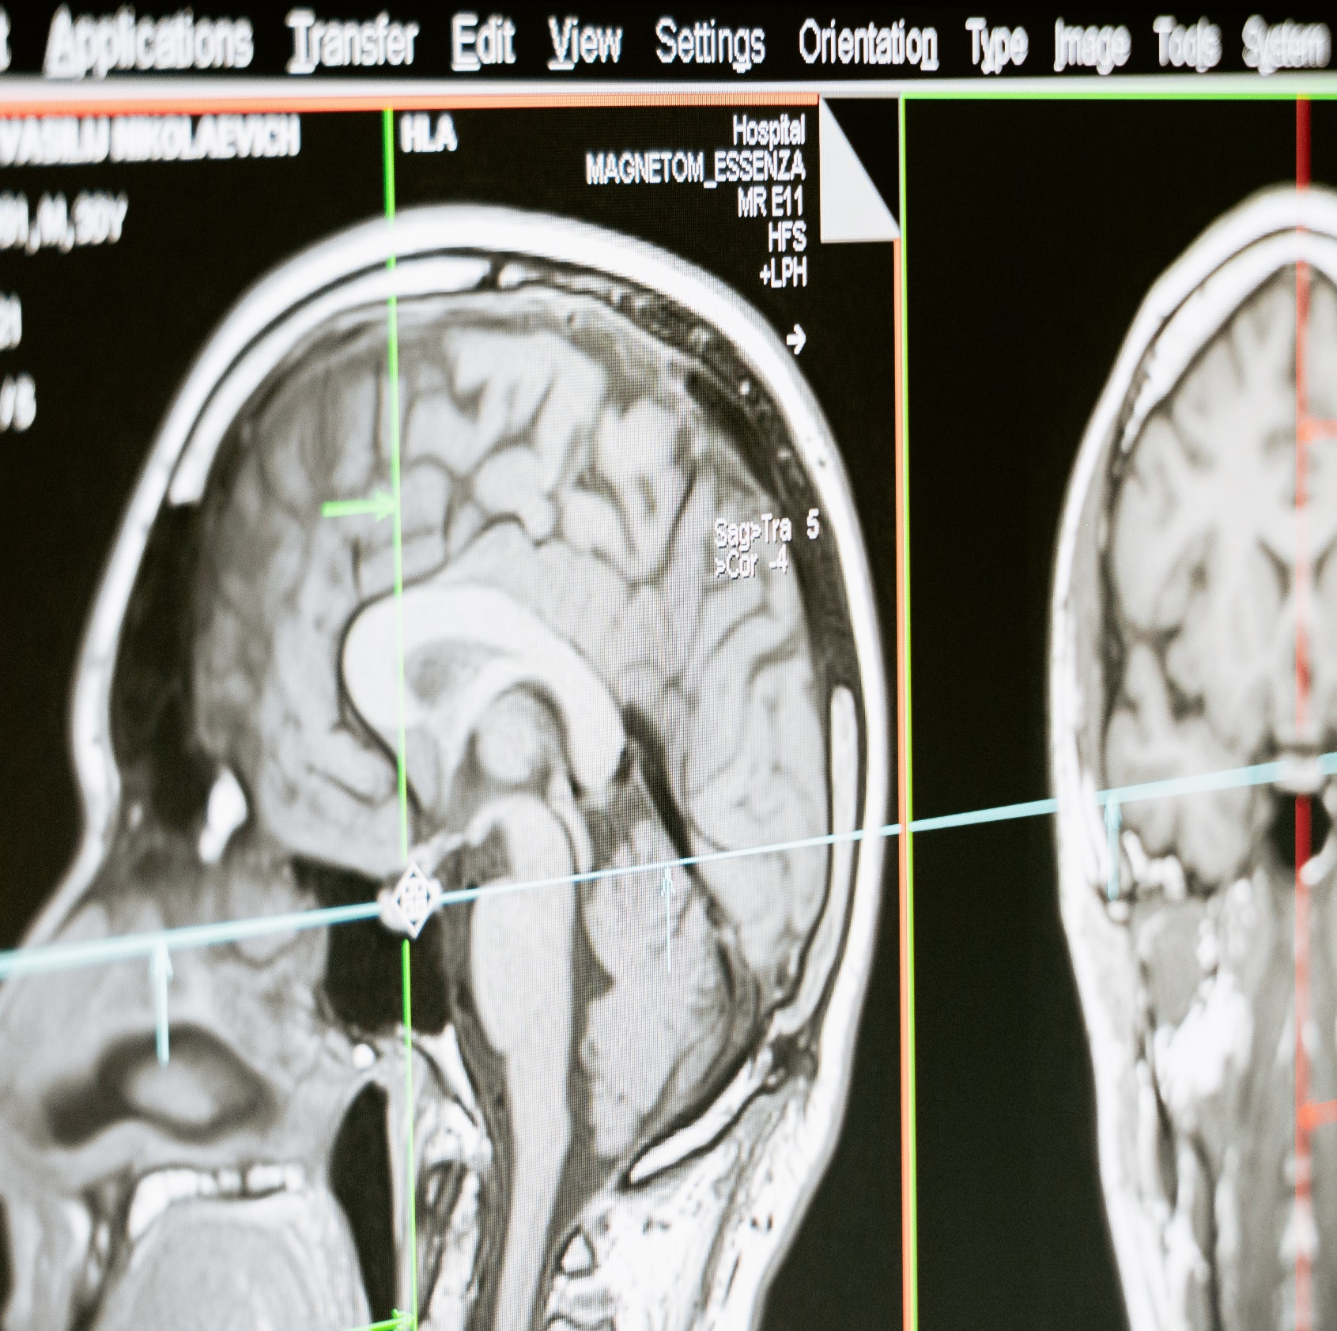
Brain Tumor detection using Convolutional Neural Network
Shubham Raj (27)
Sandeep (31)
PROfessor: Dr. Saurabh Agrawal

Slide 2
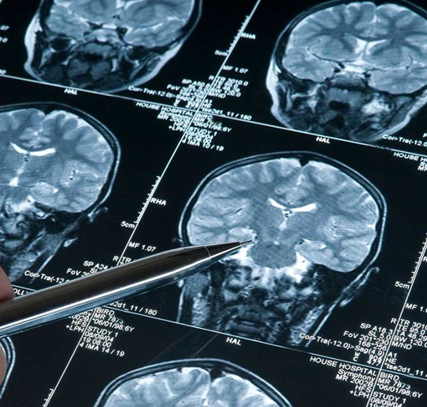
Brain Tumor
A brain tumor is a mass or growth of abnormal cells in your brain. Many different types of brain tumors exist. Some brain tumors are noncancerous (benign), and some brain tumors are cancerous (malignant).
Primary brain tumors occur in around 250,000 people a year globally, making up less than 2% of cancers.
Tumor segmentation is one of the most difficult task in a medical image.
Classification of the tumor as tumorous or non-tumorous in the primary task.

Slide 3
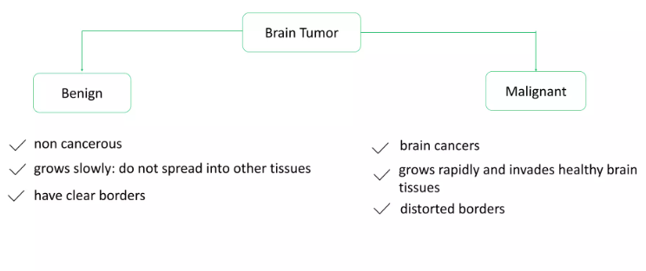
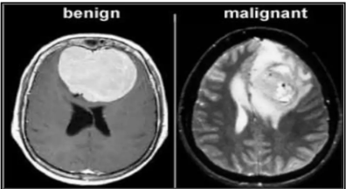
Types of Brain Tumor

Slide 4
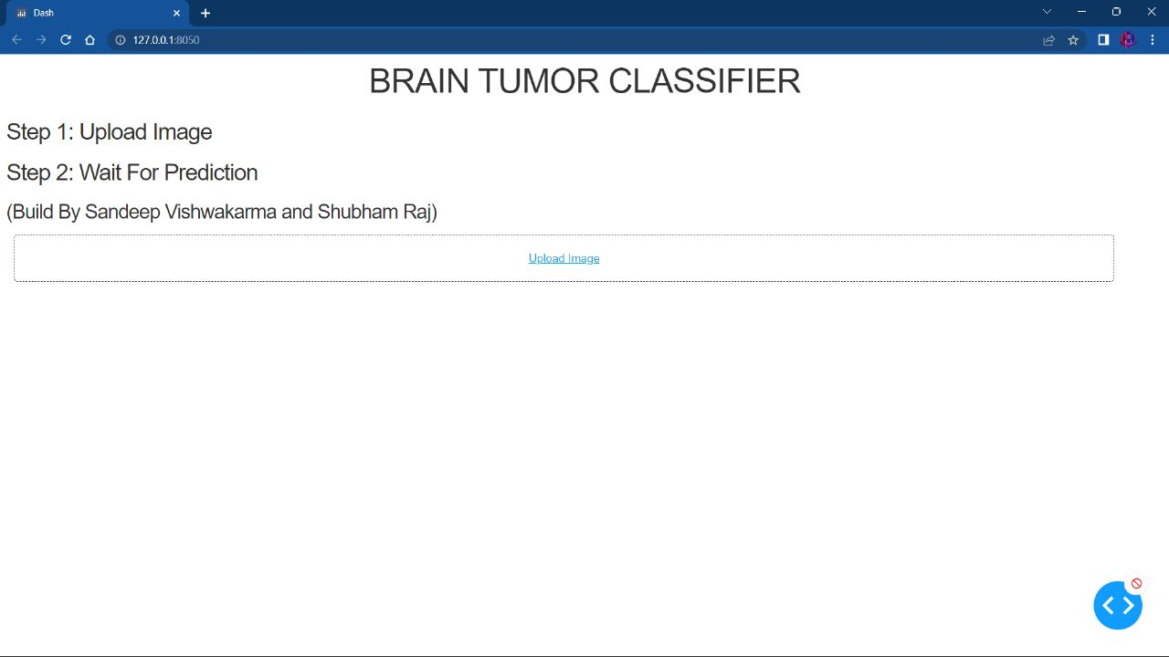
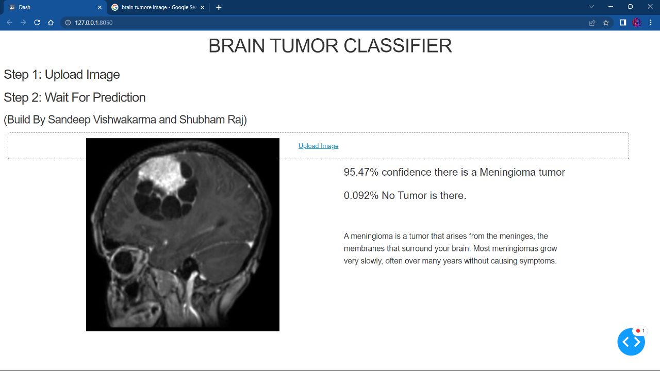
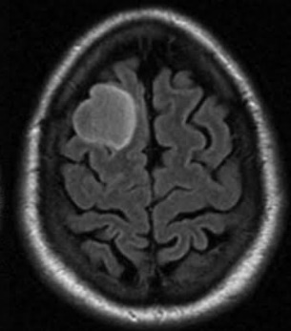

Problem statement
MRI image
Get the result (CNN model)
Upload the MRI image to the website
Doctor diagnosis

Slide 5
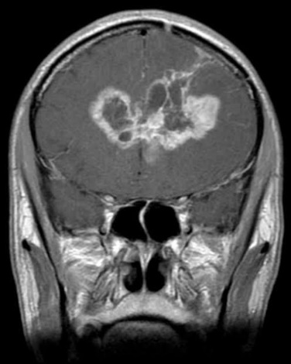
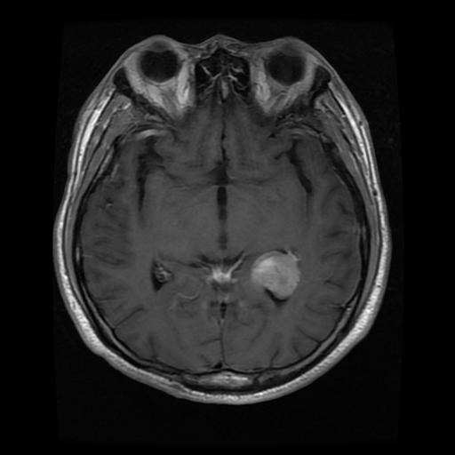
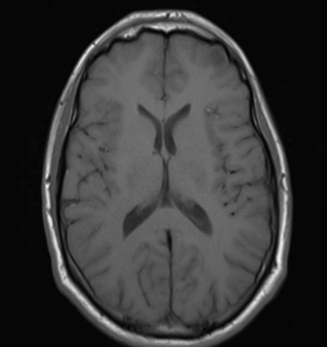
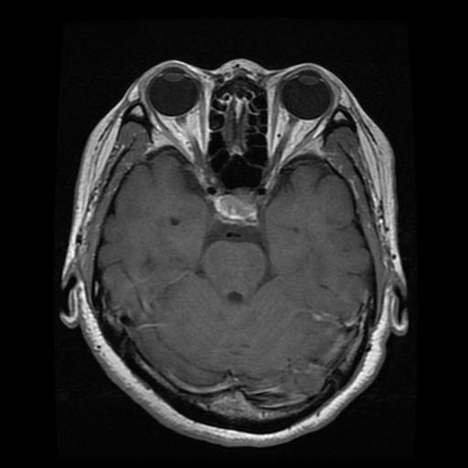
Dataset (Link: https://www.kaggle.com/datasets/sartajbhuvaji/brain-tumor-classification-mri)
Brain Tumor Classification (MRI)
Training (80)
Testing (20)
glioma_tumor (826file)
meningioma_tumor
(822files)
no_tumor
(395files)
pituitary_tumor
(825files)
glioma_tumor
(100file)
meningioma_tumor
(115files)
no_tumor
(105files)
pituitary_tumor
(74files)
Fig: Some examples of glioma_tumor meningioma_tumor no_tumor pituitary_tumor

Slide 6
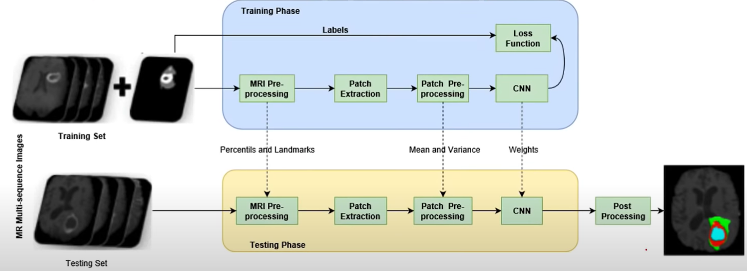


METHODOLOGY
Dataset
(80%)
(20%)

Slide 7
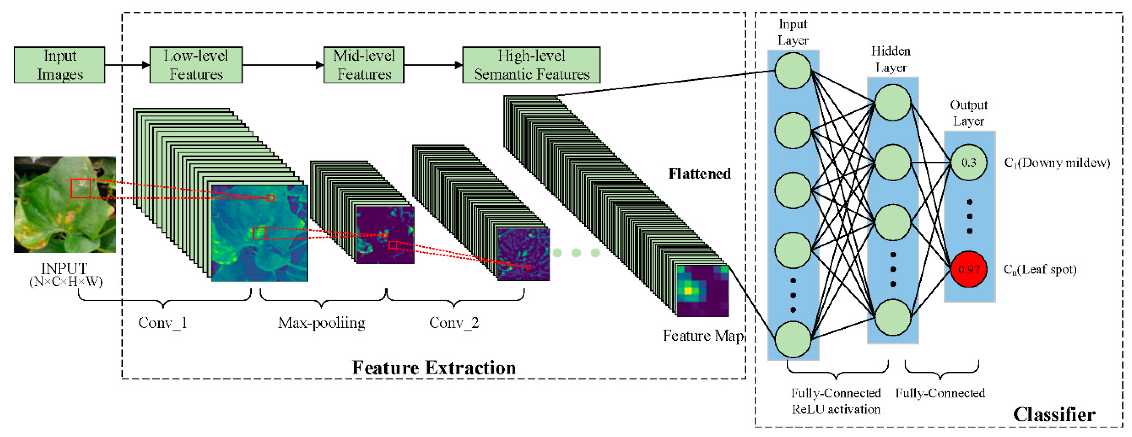

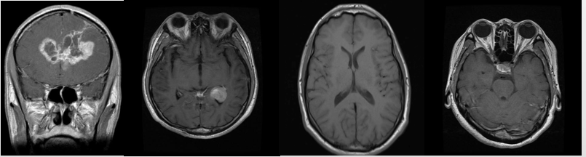

METHODOLOGY (CNN)
glioma_tumor
meningioma_tumor
no_tumor
pituitary_tumor
A
B
C
D

Slide 8

Steps to build an CNN model
Step1 – Import Required libraries
Step2 – Initializing CNN & add a convolutional layer
Step3 – Pooling operation
Step4 – Add two convolutional layers
Step5 – Flattening operation
Step6 – Fully connected layer & output layer

Slide 9
References
Brain Tumor Detection and Classification Using Convolutional Neural Network and Deep Neural Network(https://ieeexplore.ieee.org/document/9132874)
A Deep Learning Approach for Brain Tumor Classification and Segmentation Using a Multiscale Convolutional Neural Network (https://www.ncbi.nlm.nih.gov/pmc/articles/PMC7912940/)
https://www.tensorflow.org/
https://www.python.org/doc/

Slide 10

THANK YOU

